Slide 1
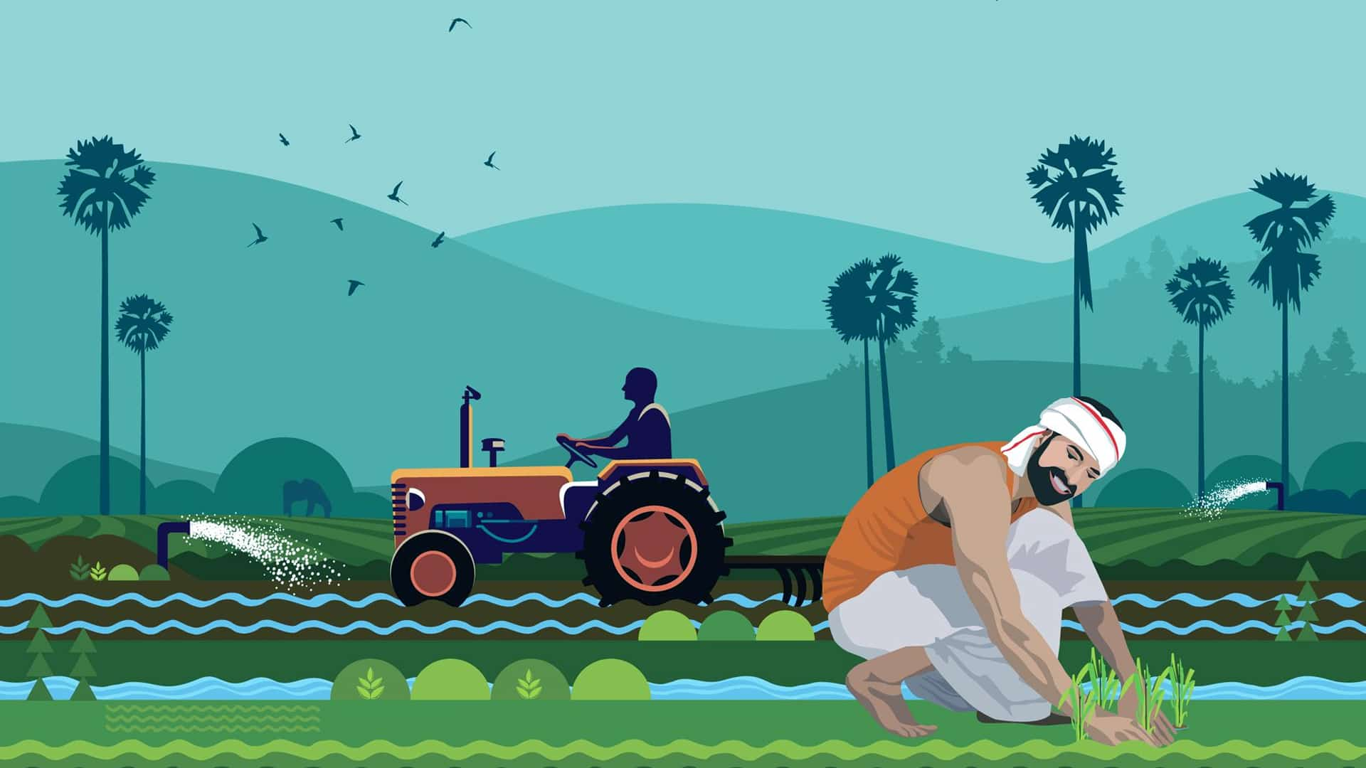
India Crop Production Report : 1997-2015
By, Prem Ghadge
UNID : UMIP23583

Slide 2
Introduction
This dashboard offers deep insights into the agricultural landscape across various states and districts, helping to visualize and understand crop production trends and dynamics.

Slide 3
Details of Data
TimeLine
1997 -2015
Crop
Year Of Production
Category
Season
Area
Production
Demography
State
District

Slide 4
Main KPI’s
Total Production: Total production of crops.
Total Area Cultivated: Total area cultivated for crops.

Slide 5
Mock-up Dashboard
(Same for all pages)
Title
Filter Panel
KPI1
KPI2
District
Year
Chart 1
Chart 3
Season
Map
Clear Filter
Chart 2
Chart 4

Slide 6
Home
LOGO
Title
Button
Button
Button
Button
(for navigation)

Slide 7
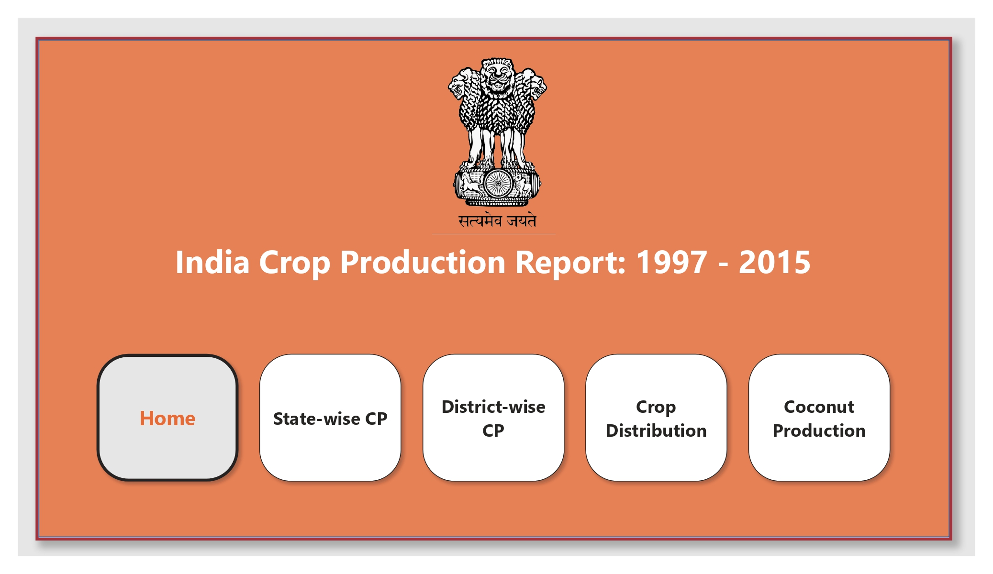
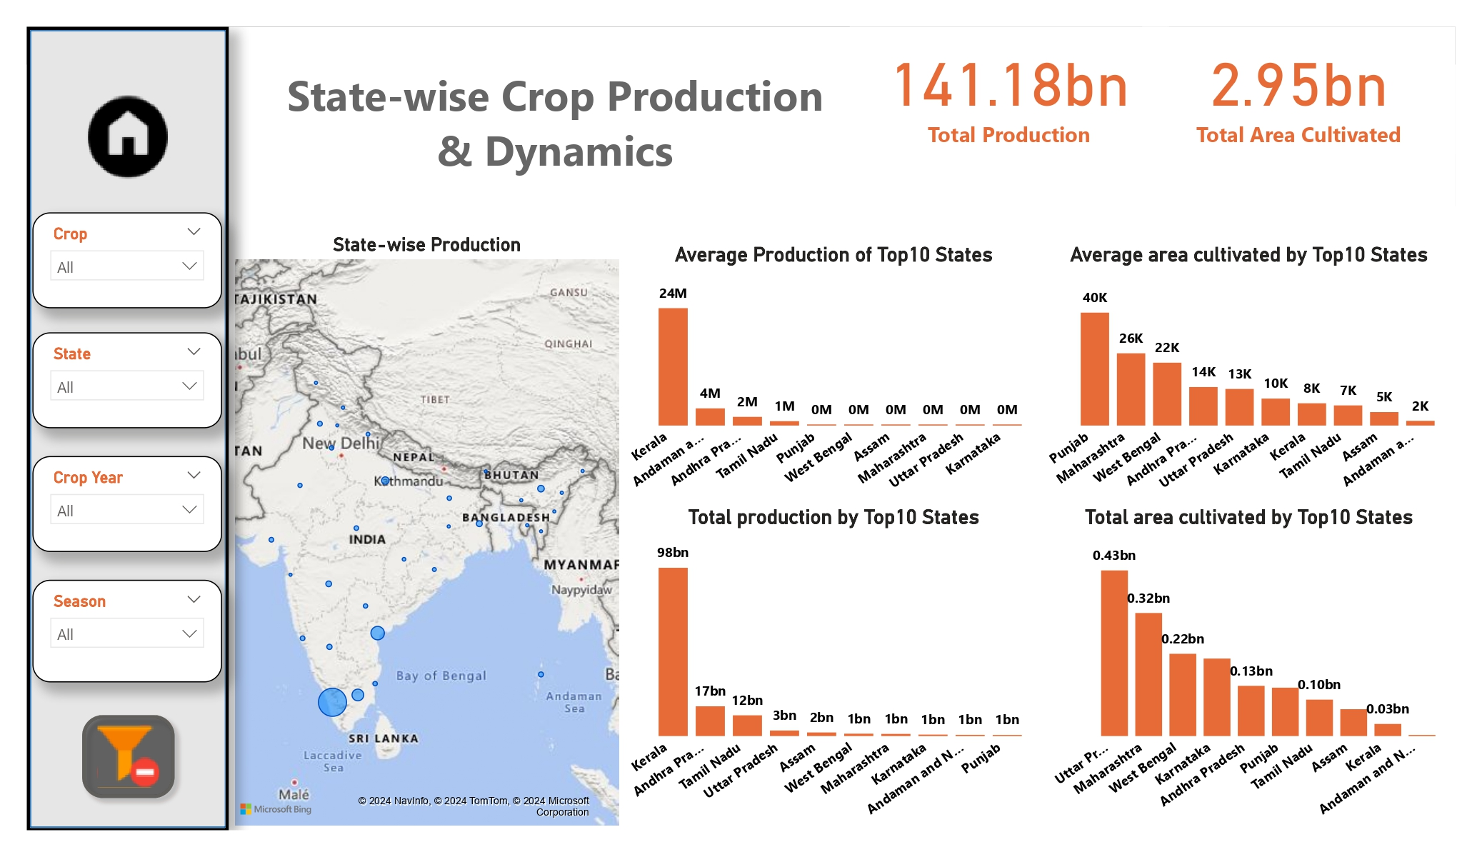
My Design
Home Page
Stat-wise Production Page

Slide 8
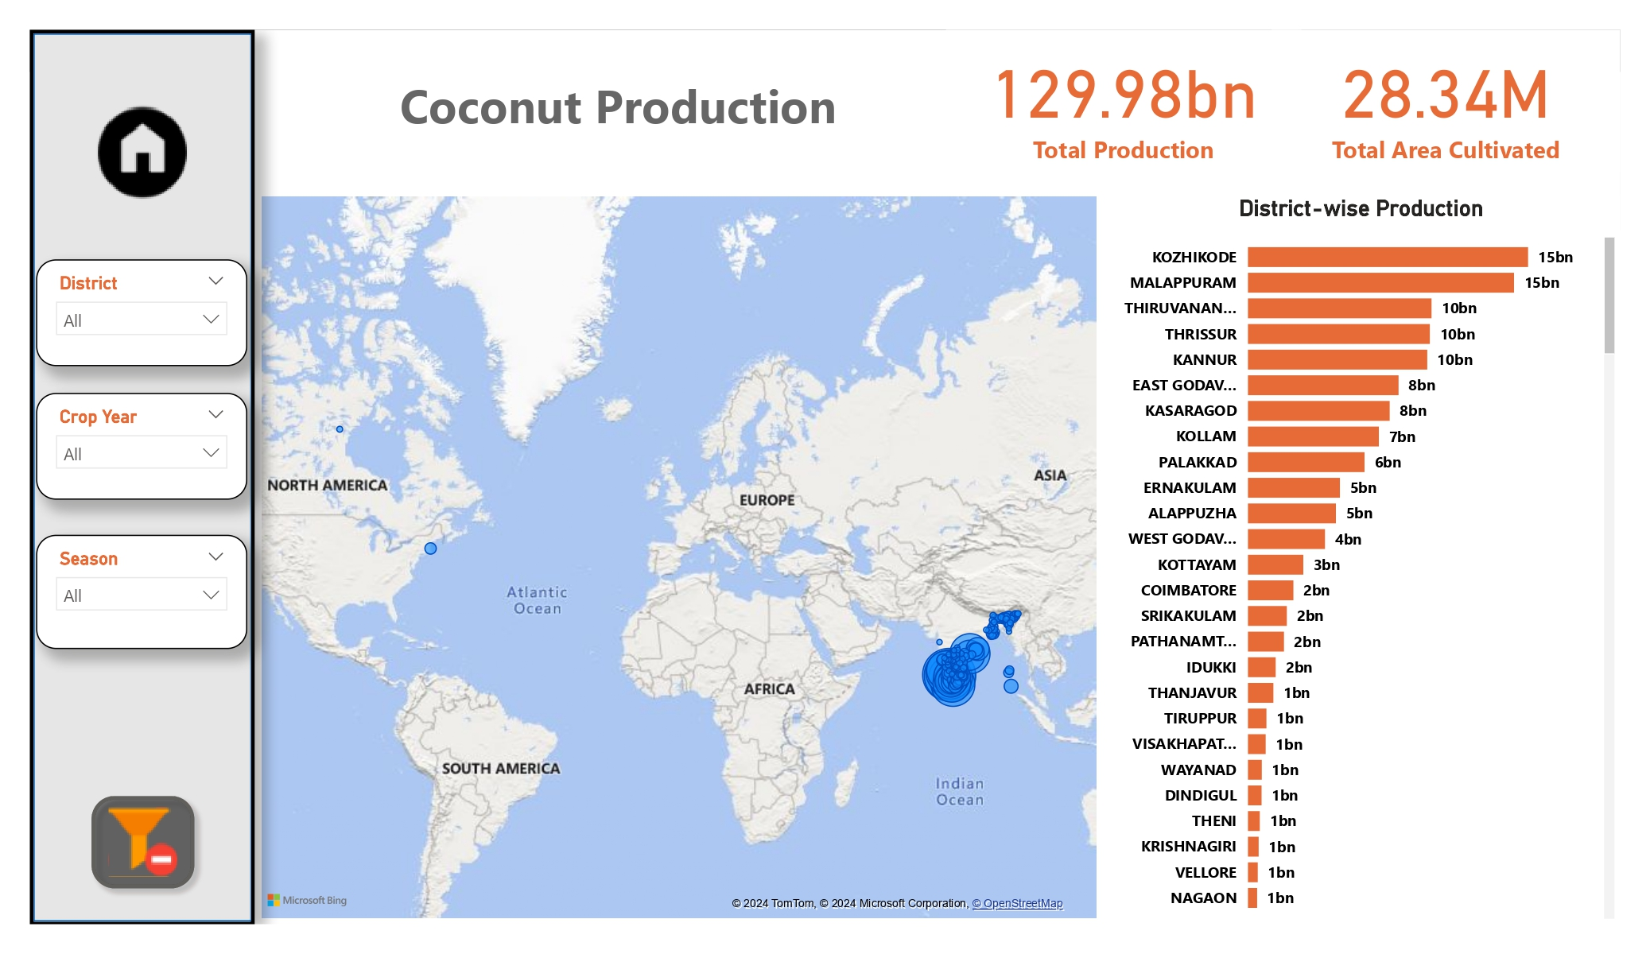
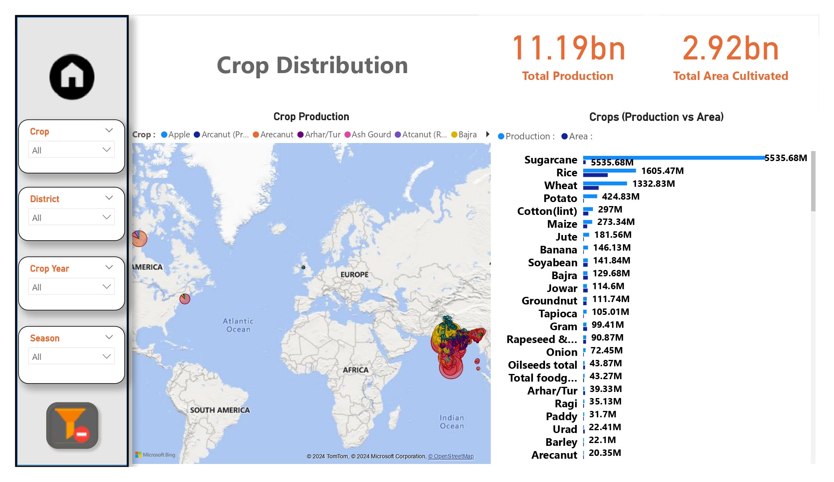
Coconut Production Page
Crop Distribution Page

Slide 9
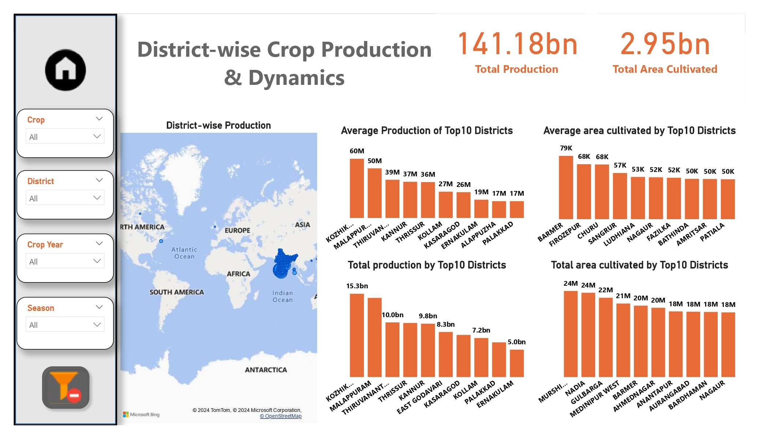
District-wise Production Page

Slide 10
Thank You

